Slide 1
LPG Gas Cylinder Monitoring Based On IOT

Slide 2
Team members
K.C.Mohan Kumar (191312129)
V.Venu Gopal Reddy (191312154)
K.Venkata Teja (191312124)
GUIDE: MR.REJI

Slide 3
AIM
Our aim is to develop a system which is used for real time monitoring of the lpg cylinder and it should intimate to the user when the quantity of the gas is under threshold limit

Slide 4
ABSTRACT
A cost-effective, automatic Liquefied Petroleum Gas (LPG) real time gas monitoring In this system, the LPG Quantity is monitored through the sensor and information is sent to the user by Short Message Service (SMS) using GSM module,and its staistics can be viewed using thinkspeak through Iot concept. The main advantage of the system is the advance intimation of cylinder quantity so that the user can book cylinder in advance.

Slide 5
Applications and Advantages:
Applications of GSM based LPG weight detection System:
This project can be used any where for real time monitoring the cylinder quantity.
1) Domestic purpose: In our home, in our day to day basis we use LPG gas cylinder. Mainly we use it for cooking purpose and for various other purposes like boiling the water and some other functions. So this project can be used for domestic use where daily usage statistics can be viewed
. 2) Hotels: Hotels are one of the largest areas where LPG gas is used. Mainly for cooking food.
Hotels and restaurant use large number of LPG gas cylinders. So this is the area where our project finds its most suitable application
.
3) Industry: In industries, LPG gas is used or some other gas cylinders are used mainly for welding purposes or cutting purposes or hitting purposes. With the use of this project, the industry owner can be intimated about the gas weight or the gas availability.
Advantages of GSM based LPG weight
This project is easy to use. And this project is fully automated so no human attention is required.
It avoids the problematic situation or the trouble caused due to unavailability of gas cylinder. Generally unavailability is caused by late intimation or late booking of gas cylinder.
This project helps to know the statistics of the cylinder quantity

Slide 6
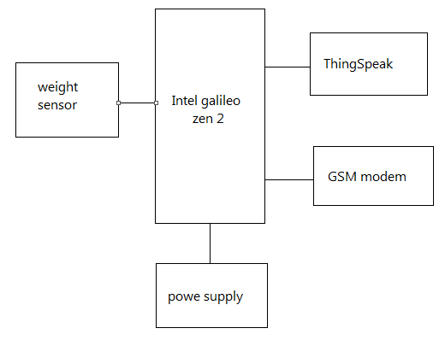
BLOCK DIAGRAM

Slide 7
Intel® Galileo Gen 2
The Intel® Galileo Gen 2 board is based on the Intel® Quark SoC X1000, a 32-bit Intel Pentium®-class system on a chip (SoC). It is the first board based on Intel® architecture designed to be hardware and software pin-compatible with shields designed for the Arduino Uno R3.
The Galileo board is also software-compatible with the Arduino Software Development Environment, which makes getting started a snap.
In addition to Arduino hardware and software compatibility, the Galileo board has several PC industry standard I/O ports and features to expand native usage and capabilities beyond the Arduino shield ecosystem. A full sized mini-PCI Express slot, 100Mb Ethernet port, Micro-SD slot, USB TTL UART header, USB Host port, USB Client Port, and 8 MByte NOR flash come standard on the board.
The genuine Intel processor and surrounding native I/O capabilities of the SoC provides for a fully featured offering for both the maker community and students alike. It will also be useful to professional developers who are looking for a simple and cost effective development environment to the more complex Intel® Atom™ processor and Intel® Core™ processor-based designs.

Slide 8
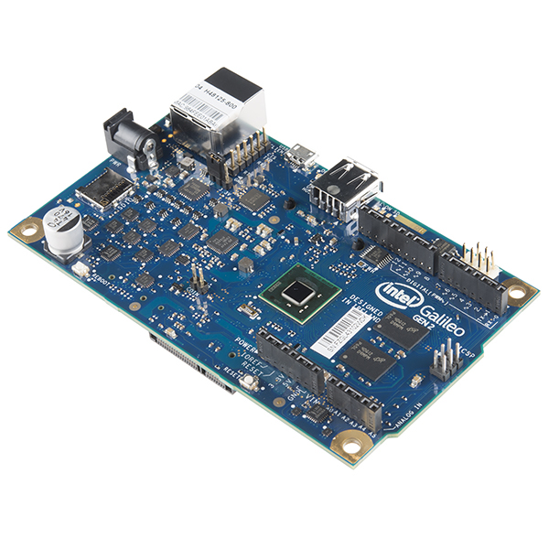

Slide 9
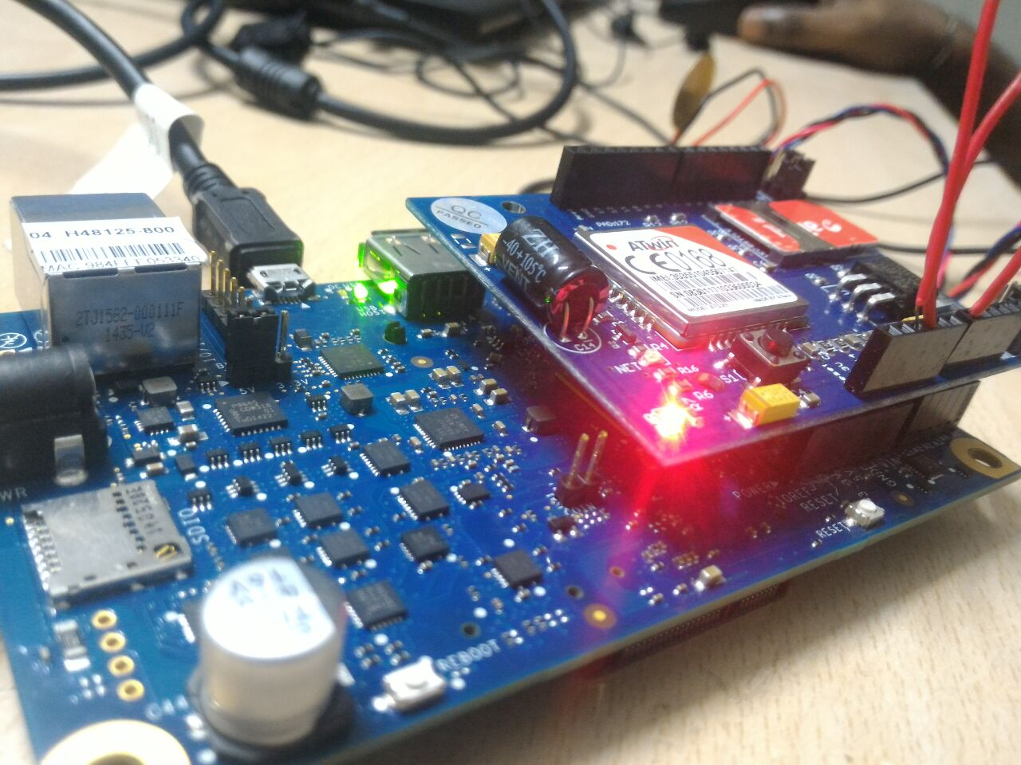
GSM ON GALILIEO

Slide 10
PROGRAM
---------------------------------------------------------------------------------------------------------------------------------------------------------------------------------------------------------- LPG GAS CYLINDER MONITRORING USING IOT
----------------------------------------------------------------------------------------------------------------------------------------------------------------------------------------------------------
#include<String.h>
const int sensepin= A0;
const int threshold=50;//threshold Weight for Gas cylinder
int reading;
void setup() {
// put your setup code here, to run once:
Serial.begin(9600);//initialisation for client communication
Serial1.begin(115200);//initialisation serial communication with GSM shield
delay(100);
}

Slide 11
void loop()
{
// put your main code here, to run repeatedly:
reading = analogRead(sensepin);//to read the value from the sensor
Serial.println(reading);//to print the values from sensor
if (reading > threshold)
{
Serial1.println("AT+CMGF=1"); //Sets the GSM Module in Text Mode
delay(1000); // Delay of 1000 milli seconds or 1 second
Serial1.println("AT+CMGS=\"+919789950995\"\r"); // Replace x with mobile number
delay(1000);
Serial1.println(" Cylinder status\nYour Gas is under treshold Limit\n Please Book for Cylinder\nThank you..Intel Galelio Gen 2");// The SMS text you want to send
delay(100);
Serial1.println((char)26);// ASCII code of CTRL+Z
delay(1000);
}
/*if(Serial1.available())
{
Serial.write(Serial1.read());
delay(10000);
}*/
}

Slide 12
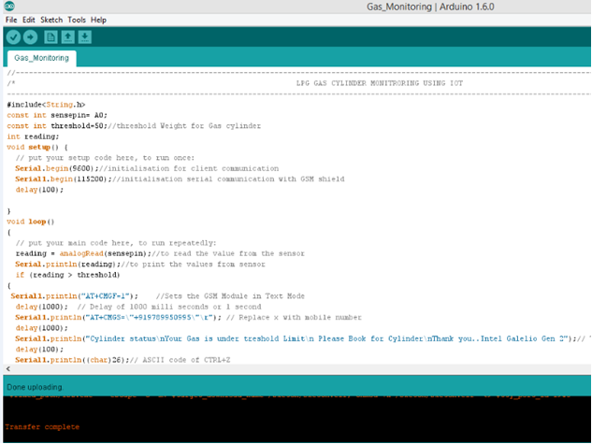

Slide 13
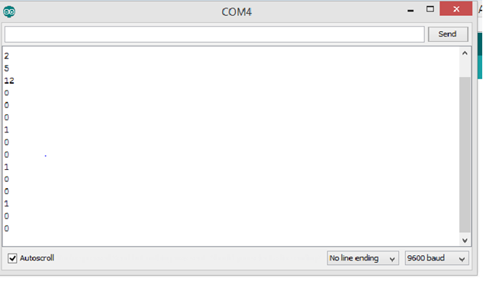
OUTPUT ANALYSIS
Sensor test:

Slide 14
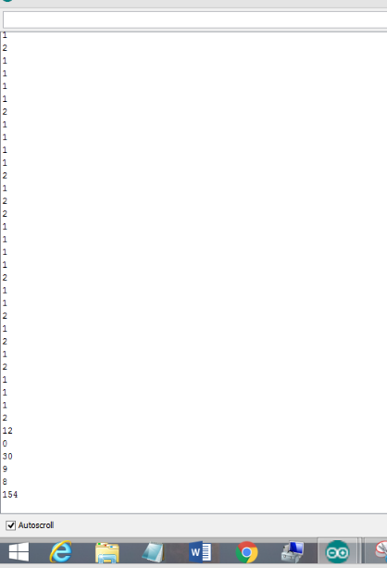
PROGRAM OUTPUT:on serial screen

Slide 15
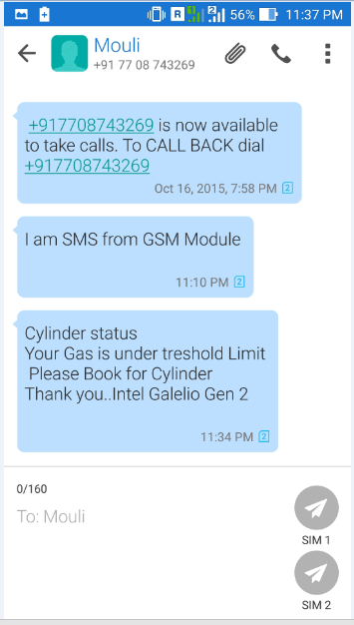
OUTPUT:

Slide 16
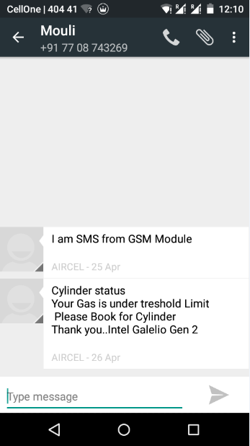
OUTPUT:

Slide 17
CONCLUSION:
An effective gas monitoring is proposed and developed using intel galilieo zen 2 and GSM shield where the quantity of gas in measured using load cell and when the level is below the threshold limit the LPG user is intimated in advance so the he can book the cylinder in advance

